Slide 1

An Introduction to

Slide 2
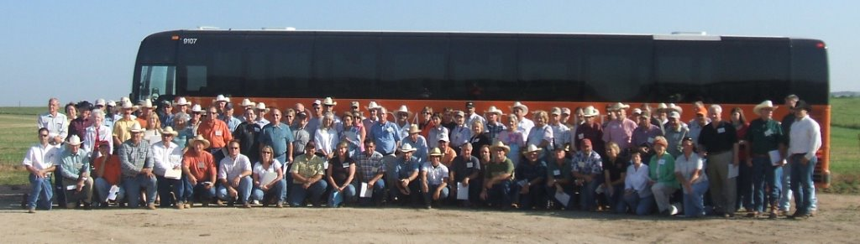
The OSU Master Cattleman program is…
A comprehensive educational curriculum for beef cattle producers with opportunities for continuing education.

Slide 3
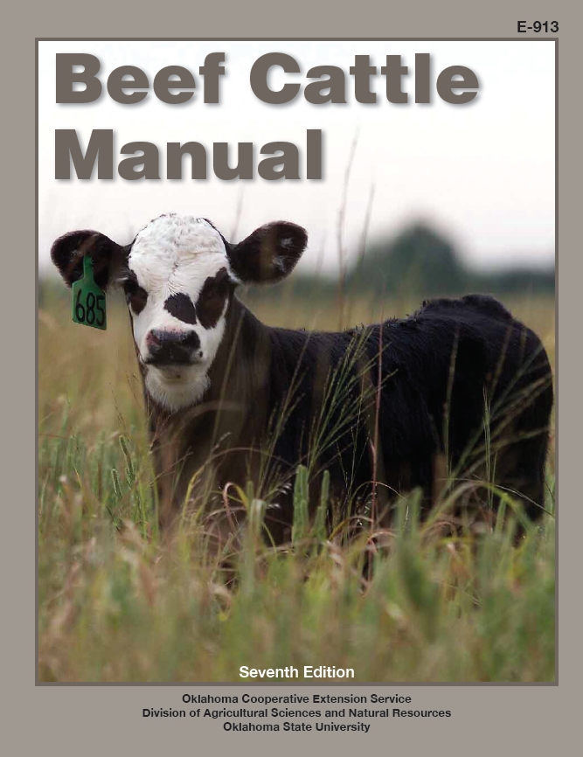
Research based information
Not only production information but also
  Business planning and analysis
  Marketing and risk management
  Natural resources
  Beef Quality Assurance
  Biosecurity

Slide 4
Master Cattleman certification requirements
4 hours each from:
Business planning and management
Marketing and risk management
Nutrition and production management
Animal health and quality assurance
Managing natural resources
Genetics and reproduction
plus
Electives, 4 to 8 hrs and (or) a special project
= 28 credit hours total

Slide 5
Business Planning and Management
Ranch Business Planning and Management
Analyzing Financial and Production Performance
Leasing Arrangements in a Beef Cattle Enterprise
Business Organization and Tax Considerations
Economic Considerations in Disaster Management

Slide 6
Marketing and Risk Management
Beef Cow-Calf Marketing
Value-Added Marketing Opportunities
Livestock and Forage Insurance Options
Beef Industry Issues and the Future

Slide 7
Nutrition and Management
The Ruminant Animal
Nutrient Requirements of Beef Cattle
Nutritive Value of Feeds
Alternative Feeds
Vitamin and Mineral Nutrition of Grazing Cattle
Supplementing Beef Cows
Supplementing and Feeding Calves and Stocker Cattle
Supplementation of Stocker Cattle on Small Grain Forage
Preconditioning Nutrition and Management

Slide 8
Animal Health and Quality Assurance
Herd Health
Internal Parasite Control
External Parasites on Beef Cattle
Implants and Their Use in Beef Cattle Production
Biosecurity
Beef Grading Standards
Beef Quality Assurance

Slide 9
Natural Resources
Grazing Management
Hay Production, Storage and Feeding
Small Grain Forage Management
Fire and Livestock Production
Cattle Handling and Working Facilities Design
Waste Management
Livestock Mortality Management

Slide 10
Genetics and Reproduction
Body Condition Scoring
Performance Recording Guidelines
Expected Progeny Differences
Management of Effective Mating and Crossbreeding Systems
Genetics in the Genomics Era
Development of Replacement Beef Heifers
Management Considerations for Bulls
Synchronizing Heats in Beef Cows and Heifers
Artificial Insemination
Embryo Transfer
Choosing a Calving Season
Calving Time Management for Beef Cows and Heifers

Slide 11
Master Cattleman certification requirements
Must complete
Quizzes on individual chapters
Final assessment survey

Slide 12
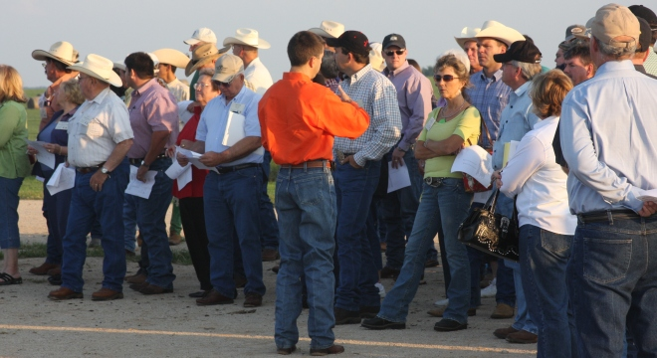
Electives
Work with local Extension Educator – Ag to plan a project appropriate for your individual situation
    Forage testing
    Soil testing
    Business plan with IFMAPS assistance
    Breeding soundness exam
    Host a demonstration
    …. Be creative!

Slide 13
Where will the program be offered and who will teach it?
Extension Educators will plan and host Master Cattleman program offerings on a county or multi-county basis.
Extension Educators, Area Specialists, and State Specialists will assist with teaching.

Slide 14
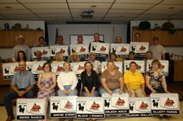
What do participants receive?
Information/education
Oklahoma Beef Cattle Manual
Master Cattleman farm gate sign
Master Cattleman certificate
Master Cattleman notebook
Local incentives

Slide 15
Cost? When and where offered?
$100 per person (or couple if sharing materials)
Extension Educators will determine when a series will be available in your area.

Slide 16
Master Cattleman website
www.agecon.okstate.edu/cattleman
View Calendar of Events
Monitor credit hours earned
Contact information for local educators
Answers to Frequently Asked Questions about the MC program

Slide 17
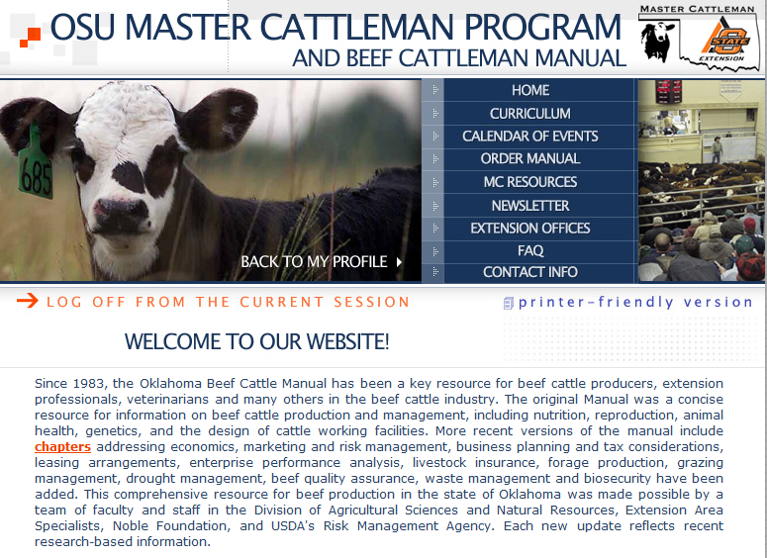

Slide 18

Questions?

